Slide 1
Weekly presentation
Civilian Duty of Gabriel Vallat

Slide 2
Previous work
Data analysis
Season dependent autocorrelation
Fourier
Modeling
Markov vs non-Markov
Random forest
Bootsrapping
Neural Networks
General form
Recurrent neural network
LSTM (Long Short Term Memory)

Slide 3

Autocorrelation
Each variables are normalized and correlated with a delayed version of themselves
$C\left(τ, s\right)\{A,w\}=\sum_{t=s}^{w+s}{\frac{(A\left(t\right)−{\overline{A}}_{t,w})∗(A\left(t+τ\right)−{\overline{A}}_{t+τ,w})}{σ_{A_{t,w}}{σ_{A}}_{t+τ,w}}}$
${\overline{A}}_{t,w}= \frac{\sum_{i=t}^{w+t}{A(i)}}{w}$ ${σ_{A}}_{t,w}=\sqrt{\frac{\sum_{i=t}^{w+t}{{(A\left(i\right)−\overline{A_{t,w} })}^{2}}}{w−1}}$
Notes:
The normalization needs to be done only on the data present in the window, otherwise the correlation could take values greater than one

Slide 4
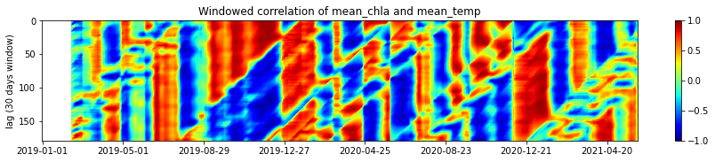

Crosscorrelation
Each variables are normalized and correlated with a delayed version of another one
$C\left(τ, s\right)\{A,B,w\}=\sum_{t=s}^{w+s}{\frac{(A\left(t\right)−{\overline{A}}_{t,w})∗(B\left(t+τ\right)−{\overline{B}}_{t+τ,w})}{σ_{A_{t,w}}{σ_{B}}_{t+τ,w}}}$

Slide 5

Fourier
The fourier transform finds the important frequencies and periodicity of the data:
$F\left(ω\right)\left\{A\right\}=\sum_{t=0}^{t=t_{f}}{Ae^{−iωt}}$
A more intuitive way of seeing the frequency is to label the periods:
$T=\frac{2π}{ω}$
To visualize this complex serie, the energy is taken:
$E\left(ω\right)=F\left(ω\right)\overline{F(ω)},$ where $\overline{F(ω)}$ is the complex conjugate of $F\left(ω\right)$
Note:
The Fourier analysis allowed to verify the use of rolling window on the high frequency data: All periods shorter than a day were reduced by using it

Slide 6
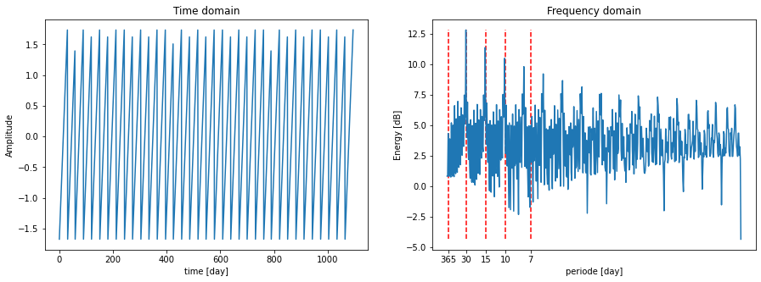
Fourier

Slide 7
Modeling: introduction
Markov vs non-Markov
Bootstrapping vs non-bootstrapping

Slide 8
Bayes networks
A system is defined by several evolving states, each represented by a random variable
A graph can be drawn where each node is a state at a given time, and each connection is the influence between states

Slide 9
Examples
White noise:
t
t+1
t+2
t+3

Slide 10
Examples
Autocorrelated signal:
Typically: the temperature of a lake
t
t+1
t+2
t+3

Slide 11
Examples
Two independent, autocorrelated signals:
Typically: the temperatures in two different lakes, that do not share any meteorological conditions
t
t+1
t+2
t+3
t
t+1
t+2
t+3

Slide 12
Examples
Two cross-correlated signals:
Typically: a simple prey-predator system
t
t+1
t+2
t+3
t
t+1
t+2
t+3

Slide 13
Examples
Measurements (with the true concentrations in blue and the measurements in yellow):
Typically: Chlorophyll a monitoring
t
t+1
t+2
t+3
t
t+1
t+2
t+3

Slide 14
Examples
Dynamic linear model:
Typically: In blue: the true levels, in yellow: the measurements
t
t+1
t+2
t+3
t
t+1
t+2
t+3

Slide 15
Examples
Non-Markov process:
Typically: Language in general, especially German
t
t+1
t+2
t+3

Slide 16
Examples
Markov process:
Typically: an isolated system
t
t+1
t+2
t+3

Slide 17
Examples
Other non-Markov process:
Typically: some other hidden process, not visible in the model, takes some time to happen
t
t+1
t+2
t+3
t
t+1
t+2
t+3

Slide 18
What about Markov process
No need to include data other than the one of the last state
Huge win in terms of dimension of the data
Requires a near perfect representation of the system: some external variables can influence it, but only if they are not themselves influenced by any of the states

Slide 19
Bootstrapping
Without bootsrapping:
Note: the true physical relations are represented by blue arrows, while the one used by the model are shown in yellow
t-3
t-2
t-1
t
t+1
t+2
t+3
t+4
Measurements
Predictions

Slide 20
Bootstrapping
With bootsrapping:
Note: the true physical relations are represented by blue arrows, while the one used by the model are shown in yellow
t-3
t-2
t-1
t
t+1
t+2
t+3
t+4
Measurements
Predictions

Slide 21
Bootstrapping
Advantages:
Less parameters to learn
Generally closer to the real physical process behind the change of state
Inconvenient
The error is integrated:
Especially bad in chaotic systems
Does not matter much in linear systems

Slide 22
Random Forests applied to chlorophyll a prediction
Train a random forest predict the level of chlorophyll a at a lag l
t-3
t-2
t-1
t
t+l
t-3
t-2
t-1
t
Predictions
t-3
t-2
t-1
t
Measurements

Slide 23
Random Forests applied to chlorophyll a prediction
Inconvenient:
The random forest needs to be retrained for each lag
The model does not presuppose:
That the variable of a same time series are linked
That the old data are probably less important than the new ones
Advantage:
Learning is fast (compared to a neural network)
This model quickly gets overwhelmed when too many explanatory variables are given to it

Slide 24
Bootstrapped Random Forest
Idea: Reuse the prediction to forecast further in time:
t-1
t
t+1
t-1
t
t+1
t-1
t
t+1
Measurements
Predictions

Slide 25
Bootstrapped Random Forest
Idea: Reuse the prediction to forecast further in time:
t
t+1
t+2
t
t+1
t+2
t
t+1
t+2
Measurements
Predictions

Slide 26
Bootstrapped Random Forest
Idea: Reuse the prediction to forecast further in time:
t+1
t+2
t+3
t+1
t+2
t+3
t+1
t+2
t+3
Measurements
Predictions

Slide 27
Bootstrapped Random Forest
Inconvenient
Need to predict all the explanatory variables
Reduce the number of inputs that can be used
No hidden states:
A bad prediction in one variable impact all the others
Two very correlated variables would need to be predicted twice from scratch
Exponential increase in error
Advantage:
Can predict as many days in advance as needed, without retraining the forest
Mimics a bit more what is physically happening

Slide 28
Bootstrapped Random Forest
When to use this model:
Low dimensional
Long term predictions (with respect to the size of the timeseries)
No chaotic signals
Markov process
Our case
High dimensional timeseries
Short term prediction
Chaotic

Slide 29
Neural Networks

Slide 30

Neural network
Main idea:
combine a lot of easy to compute functions to estimate a complex one.
x₁
$$y=φ\left(b+\sum{w_{i}x_{i}}\right)$$
x₂
y
b and w need to be learned
x₃
neuron
input

Slide 31
Neural network
Main problem:
lots of weights to chose
x₁
y₁
x₂
y₂
x₃
y₃
input
layer
output
hidden neurons

Slide 32
Specific Neural networks
Delete some connection
x₁
y₁
x₂
y₂
x₃
y₃
input
layer
output
hidden neurons

Slide 33
Specific Neural networks
Reuse some connections
x₁
y₁
x₂
y₂
x₃
y₃
input
layer
output
hidden neurons

Slide 34
List of specific neural networks
Convolution Neural Networks (CNN)
Specific to images
Only connect the neurons to points that are spatially close
Use the same connections
Recurrent Neural Networks (RNN)
Specific to time series
Reuse the same weights at each time steps
More about it later

Slide 35
Recurrent Neural networks
Memorize the past
x(t)
x(t+1)
output
input
layer
hidden neurons

Slide 36
Recurrent Neural networks
Can be unfolded
Hidden state t
Hidden state t+1
x(t)
x(t+1)
output
input
layer
hidden neurons

Slide 37
RNN vs Random Forest
RNN:
Have hidden states that represent some useful abstract characteristics of the system
These states can store long-term dependencies, but are naturally prone to focus on short ones
Intrinsically bootstrapped
Random Forest
Do not have any abstract measure, can only estimate output variables
A bad prediction cannot be discarded
Do not have any a priori on whether short term or long-term relationship are more useful
Can be bootstrapped if needed, not in general

Slide 38

RNN: The problems
State exploding/vanishing:
As the states evolve in the form
$s\left(t+1\right)=A∗s\left(t\right)+B$
The importance of a state long is either going to 0 (if A < 1) or to infinity (if A > 1)
Causes chaotic behaviour where a small change in A result in a big change in s
Example: s(t+15) = 0.21*s(t) if A = 0.9 and B = 0
Example: s(t+15) = 4.17*s(t) if A = 1.1 and B = 0
The states need to be initialized at an arbitrary value
s(0) = 0

Slide 39
LSTM
Replace naive recurrent neuron with a unit:
s(t)
s(t+1)
x(t)

Slide 40
LSTM
Replace naive recurrent neuron with a unit:
c(t)
c(t+1)
h(t)
h(t+1)
x(t)

Slide 41
LSTM
Replace naive recurrent neuron with a unit:
x(t)
h(t)

Slide 42





Gates
Gates are the basis of attention
Principle: Multiply the value of two neurons
c(t)
c(t+1)
$$φ_{tanh}$$
$$φ_{σ}$$
$$φ_{σ}$$
$$φ_{tanh}$$
h(t)
$$φ_{σ}$$
h(t+1)
x(t)

Slide 43
Summary RNN
RNN are a type of neural networks that is tuned to predict time series
LSTM are a type of RNN that can learn long time dependencies more easily

Slide 44
Content table second presentation
Seq2Seq
Attention
Transformers
How to chose the parameters
Gradient descent
Stochastic gradient descent
Momentum

Slide 45
2nd weekly presentation
Summary:
Seq2seq
Attention
Optimization of neural networks
Gradient descent
Stochastic gradient descent
Momentum
Overfitting

Slide 46
Reminder
Recurrent neural networks are good at processing time series
x(t)
x(t+1)
output
input
layer
hidden neurons

Slide 47
Encoder / Decoder
How to initialize the weights?
?
?
x(0)
x(1)
?
?
output
input
layer
hidden neurons

Slide 48
Encoder / Decoder
To initialize the weights:
Use some past values (t<0)
Encoded context
x(t)
input
layer
Encoder

Slide 49
Encoder / Decoder
To predict:
Use the encoded context (if t=0)
Use the last prediction (if t>0)
Encoded context
x(0)
x(1)
output
input
layer
Decoder

Slide 50
Encoder / Decoder
To predict:
Use the encoded context (if t=0)
Use the last prediction (if t>0)
x(t)
x(t)
output
input
layer
Decoder

Slide 51
Encoder / Decoder
Advantages:
Can learn different value for initializing and updating the states
Example: For chlorophyll a forecasting, the model can use the precipitation in the encoder, but as they are not predictable, they can be discarded in the decoder
Disadvantages:
The balance between the encoded context and its update is optimized for a given length of time, thus it cannot predict arbitrary values in advance
This requires to teach a model 2 time bigger

Slide 52
Attention
Main idea:
To learn which variables are important

Slide 53
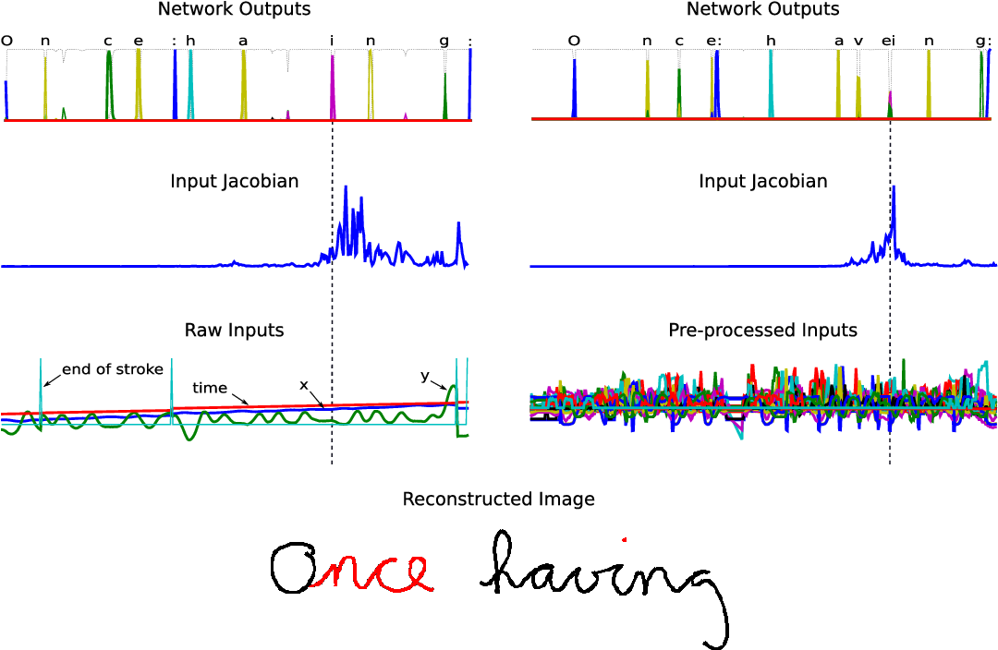
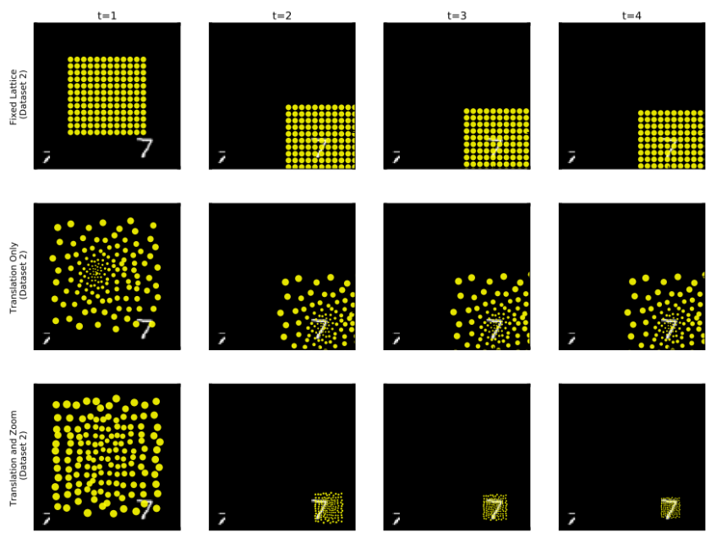
Attention
Different kinds:
Positional
Example: Mimic of the foveal movement of the eye
Temporal
Example: Learning to reconstruct handwritting
Content-based
Example: Transformer
….

Slide 54
Attention
Main idea:
Learn which variable the network can forget

Slide 55
Attention
Main idea:
Learn which variable the network can forget
Content-Based attention: the data create the attention map

Slide 56
Attention
The basic principle:
value
x₁
Query
x₂
input
key

Slide 57
Attention
The basic principle:
x represent all the data, from all the different time steps and all the different variables
v
y
x
q
input
k
Attention head

Slide 58
Attention
The basic principle:
x represent all the data, from all the different time steps and all the different variables
V
y
x
Q
input
K
Attention head

Slide 59
Attention: Multihead
The basic principle:
x represent all the data, from all the different time steps and all the different variables
V
Q
K
y
x
V
Q
input
K
V
Q
K

Slide 60
Attention
The basic principle:
x represent all the data, from all the different time steps and all the different variables
V
V
Q
Q
K
K
x
V
V
Q
Q
input
K
K
V
V
Q
Q
K
K

Slide 61
Attention: Encoder / Decoder
The basic principle:
x represent all the data, from all the different time steps and all the different variables
V
Q
K
x
V
Q
K
V
Q
K
V
V
Q
Q
K
K
V
V
Q
Q
K
K
V
V
Q
Q
K
K

Slide 62
Transformer
Advantages:
Limit the state vanishing/exploding problem
Allows for bigger models
Allows for long term relationship
The attention matrix (QK) gives an easily understandable look into what is important
Disadvantage:
As the models get bigger, uses more memory to train
Generally slower
Harder to parallelize
Less locally biased

Slide 63



Gradient descent
Gradient descent
$x_{t+1 }=x_{t}−αf′(x_{t})$
$${f(x}_{0 })$$
$$x_{0 }$$
x

Slide 64

Gradient descent
Gradient descent
$x_{t+1 }=x_{t}−αf′(x_{t})$
$$α$$
$$x_{0 }$$
x

Slide 65


Gradient descent
Gradient descent
$x_{t+1 }=x_{t}−αf′(x_{t})$
$$α$$
$$x_{0 }$$
$$x_{1 }$$
x

Slide 66


Gradient descent
Newton method:
$x_{t+1 }=x_{t}−αf′(x_{t})$
$$f(x_{1})$$
$$x_{0 }$$
$$x_{1 }$$
x

Slide 67

Gradient descent
Gradient descent
$x_{t+1 }=x_{t}−αf′(x_{t})$
$$α$$
$$x_{0 }$$
$$x_{1 }$$
x

Slide 68

Gradient descent
Gradient descent
$x_{t+1 }=x_{t}−αf′(x_{t})$
$$α$$
$$x_{0 }$$
$$x_{1 }$$
$$x_{2 }$$
x

Slide 69

Gradient descent
Gradient descent
$x_{t+1 }=x_{t}−αf′(x_{t})$
$$f(x_{2})$$
$$x_{0 }$$
$$x_{1 }$$
$$x_{2 }$$
x

Slide 70


Gradient descent
Gradient descent
$x_{t+1 }=x_{t}−αf′(x_{t})$
$$α$$
$$x_{0 }$$
$$x_{1 }$$
$$x_{2 }$$
$$x_{3 }$$
x

Slide 71

Gradient descent
Gradient descent
$x_{t+1 }=x_{t}−αf′(x_{t})$
$$x_{0 }$$
$$x_{1 }$$
$$x_{2 }$$
$$x_{3 }$$
x

Slide 72

Gradient descent: 2 dimensions
Gradient descent
$x_{t+1 }=x_{t}−α∇f(x_{t})$

Slide 73

Gradient descent in NN
Formulation:
Prediction:
$\vec{y}=f(\vec{x},\vec{θ})$
Error (or loss) to minimize:
$loss=l\left(\vec{t},\vec{y}\right)$
ex: $loss={\left\|\vec{t}−\vec{y}\right\|}^{2}$
Naïve update rule:
$\vec{θ_{t+1}}=\vec{θ_{t}}−α∇_{θ}l\left(\vec{t},f\left(\vec{x},\vec{θ_{t}}\right)\right)$

Slide 74

Gradient descent in NN
Problem:
$\vec{x}, \vec{y}$ and $\vec{t}$ are big (all the different points and output of the dataset)
Evaluating $f(\vec{x}, \vec{θ}$) takes a lot of time
Solution:
Perform stochastic gradient descent:
break down $\vec{x}$ and $\vec{t}$ into batches of a few elements
$\vec{θ_{t+1}}=\vec{θ_{t}}−α∇_{θ}l\left(\vec{t_{b}},f\left(\vec{x_{b}},\vec{θ_{t}}\right)\right)$

Slide 75

Gradient descent: 2 dimensions
Gradient descent
$x_{t+1 }=x_{t}−α∇f\left(x_{t}\right)$

Slide 76

Gradient descent: 2 dimensions
Gradient descent
$x_{t+1 }=x_{t}−α∇f\left(x_{t}\right)$
Stoch. grad descent:
$x_{t+1 }=x_{t}−α\tilde{∇f\left(x_{t}\right)}$

Slide 77
Problems with gradient descent

Slide 78
Problems with Gradient descent
Local optimization
Can get stuck

Slide 79

Problems with Gradient descent
Worse in higher dimensions:
Saddle points
$$: ∇f\left(x_{t}\right)=0$$

Slide 80
Solution
“Shake things up”:
Use a noisy estimation of the gradient to get out of both local minima and saddle points

Slide 81
Solutions to Gradient descent
Small learning rate

Slide 82
Solutions to Gradient descent
Large learning rate

Slide 83
Solutions to Gradient descent
Small batches

Slide 84
Summary:
Neural networks use (stochastic) gradient descent to optimize their weights
One can get out of local minima by increasing the stochasticity of a model
Note: Sometimes, getting to the global minimum is not wanted (see the part about generalization)
Method to increase stochasticity:
Large learning rate
Small batches

Slide 85
What learning rate to chose?

Slide 86
Momentum
In the previous slides, the error was smooth

Slide 87
Momentum
In reality, the error is noisy
It cannot be precisely measured
The more dimensions they are, the noisier it gets

Slide 88
Momentum
Idea: More than a steep descent, priorities a stable one

Slide 89
Momentum

Slide 90
Momentum

Slide 91
Momentum

Slide 92
Momentum

Slide 93
Momentum

Slide 94
Momentum

Slide 95
Momentum

Slide 96
Momentum

Slide 97
Momentum

Slide 98
Momentum

Slide 99
Momentum

Slide 100
Momentum

Slide 101
Momentum

Slide 102

Momentum
Advantages:
Rely less on the arbitrary choice of $α$: It can simply be chosen to be very small, and it will gradually increase and stabilize
Allows to get out of local minima or saddle points
Less noise sensitive
Disadvantages:
Can be improved by using the square gradient to be more reactive in change of direction
Can be improved by computing the gradient in between time steps

Slide 103
The danger of a good optimisation
Main concepts: Overfitting

Slide 104
Overfitting
Discrete data to estimate continuous function:
The best fit during training is not forcefully the best fit over true data

Slide 105
Model Flexibility
A neural network can approximate any function given enough neurons:

Slide 106
Model Flexibility
A neural network can approximate any function given enough neurons:

Slide 107
From the training point of view
Overfitting:
-Training
- Validation

Slide 108
From the training point of view
Underfitting:
-Training
- Validation

Slide 109
From the training point of view
Good fit:
-Training
- Validation

Slide 110
How to reduce the flexibility
Smaller model
Simple, but this hyperparameter gets sensible
Early stopping:
Stop the training as soon as the validation error stop to increase
Dropout
During training, “forget” some neurons, and use all of them during testing
Like random forest: lots of bad models averaged
L2 weights
Penalize big values
Attention

Slide 111
How to allow more flexibility
Have more data
Pretrain the network
Use some data augmentation:
Artificially add some transformation or noise

Slide 112

Neural network
Common choices of $φ$:

